Slide 1
Chapter 6
The Secondary Structure
Prediction of RNA

Slide 2
Outline
Secondary Structure of RNA
The RNA Maximum Base Pair Matching Algorithm
Loop Dependent Free Energy Rules
Minimum Free Energy Algorithm

Slide 3
Secondary Structure of RNA
The function of an RNA is determined by its three-dimensional structure.
The three-dimensional of an RNA can be uniquely determined from its sequence.
It is still a hard work to predict the three-dimensional structure of an RNA directly from its sequence.

Slide 4
Secondary Structure of RNA
There are efficient algorithms to predict the secondary structure of an RNA.
The sequence of the bases A, G, C and U is called the primary structure of an RNA.
According to the thermodynamic hypothesis, the actual secondary structure of an RNA sequence is the one with minimum free energy.

Slide 5
The Base Pairs of RNA
RNA: {A, G, C, U}
Base pairs:
  G≡C (Watson-Crick base pair)
  A=U (Watson-Crick base pair)
  G−U (Wobble base pair)
The base pairs of types G≡C and A=U is more stable than that of the type G−U

Slide 6
The Base Pairs of RNA
The base pairs will increase the structural stability, but the unpaired bases will decrease the structural stability.
Given an RNA sequence, determine the secondary structure of the minimum free energy from this sequence.

Slide 7
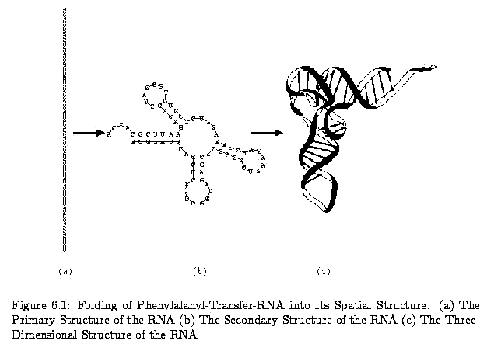
The Structure of RNA

Slide 8
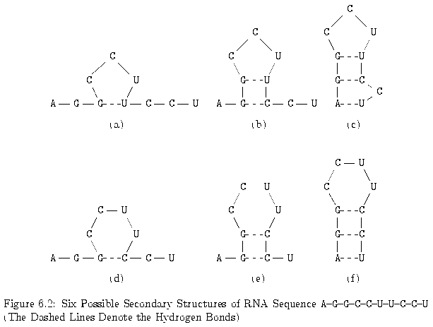
Secondary Structure of RNA

Slide 9
The Conditions of Base Pair
A secondary structure of R is a set S of base pairs (r_{i}, r_{j}),
where 1 ≤ i < j ≤ n, such that the following conditions
are satisfied.
(1) j – i > t, where t is a small positive constant.
Typically, t = 3.
(2) If (r_{i}, r_{j}) and (r_{k}, r_{l}) are two base pairs in S and i ≤ k,
then either
(a) i = k and j = l, i.e..(r_{i}, r_{j}) and (r_{k}, r_{l}) are
the same base pair,
(b) i < j < k < l, i.e., (r_{i}, r_{j}) precedes (r_{k}, r_{l}), or
(c) i < k < l < j, i.e., (r_{i}, r_{j}) includes (r_{k}, r_{l}).

Slide 10
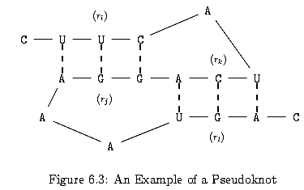
Pseudoknot
Two base pairs (r_{i},r_{j}) and (r_{k},r_{l}) are called a pseudoknot
if i < k < j < l

Slide 11


The Legal Case of Base Pair
Let WW = {(A, U), (U, A),(G, C),(C, G),(G, U),(U, G)}.
Then, we use a function ρ(r_{i},r_{j}) to indicate whether any two bases
r_{i} and r_{j} can be a legal base pair:
1 if (r_{i},r_{j}) WW
ρ(r_{i},r_{j}) =
0 otherwise
By definition, we know that RNA sequence does not fold too
sharply on itself. That is, if j – i ≤ 3, then r_{i} and r_{j} cannot be a
base pair of S_{i,j}. Hence, we let M_{i,j} = 0 if j – i ≤ 3.
To compute M_{i,j}, where j – i > 3, we consider the following cases
From r_{j} point of view.

Slide 12
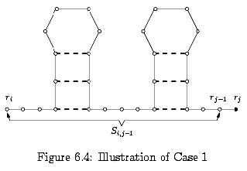
The Legal Case of Base Pair
Case 1: In the optimal solution, r_{j} is not paired with any other base.
In this case, find an optimal solution for r_{i}r_{i+1}…r_{j-1} and M_{i,j} = M_{i,j-1}.

Slide 13
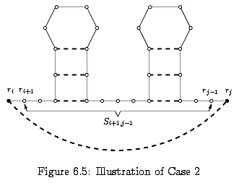
The Legal Case of Base Pair
Case 2: In the optimal solution, r_{j} is paired with r_{i} and ρ(r_{i},r_{j}) = 1.
In this case, find an optimal solution for r_{i+1}r_{i+2}…r_{j-1}and M_{i,j}=1+ M_{i+1,j-1}.

Slide 14
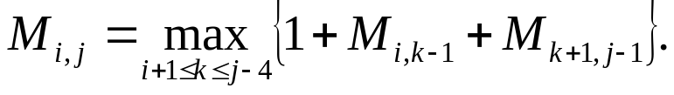
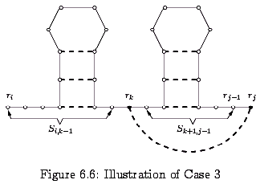
The Legal Case of Base Pair
Case 3: In the optimal solution, r_{j} is paired with some r_{k}, where
i+1 ≤ k ≤ j-4 and ρ(r_{k},rj) = 1. In this case, find an optimal solution for
r_{i+1}r_{i+2}…r_{k-1}and r_{k+1}r_{k+2}…r_{j-1} and M_{i,j} = 1 + M_{i,k-1} + M_{k+1},_{j-1}.Since we
want to find the k between i+1 and j-4 such M_{i, j} is the maximum, we
Have

Slide 15
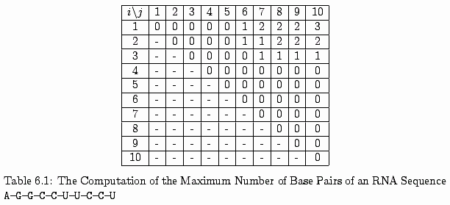
The Maximum Number of Base Pairs of the RNA Sequence

Slide 16
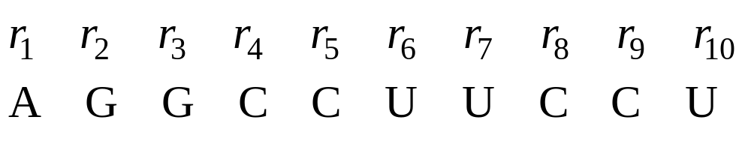
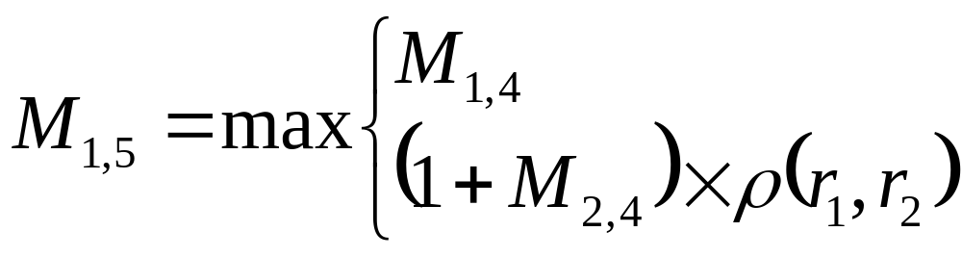
The Maximum Number of Base Pairs of the RNA Sequence
(1) i = 1, j = 5, ρ(r₁, r₅) = ρ(A, C) = 0

Slide 17
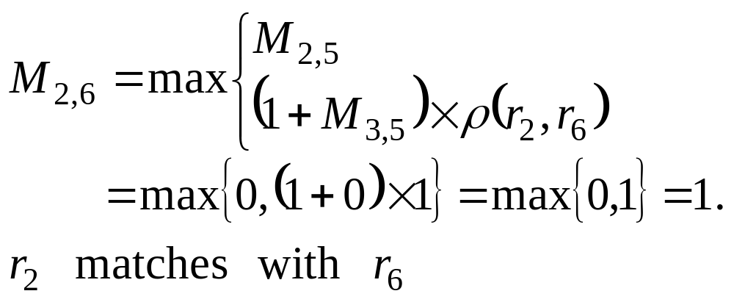
The Maximum Number of Base Pairs of the RNA Sequence
(2) i = 2, j = 6, ρ(r₂, r₆) = ρ(G, U) = 1

Slide 18
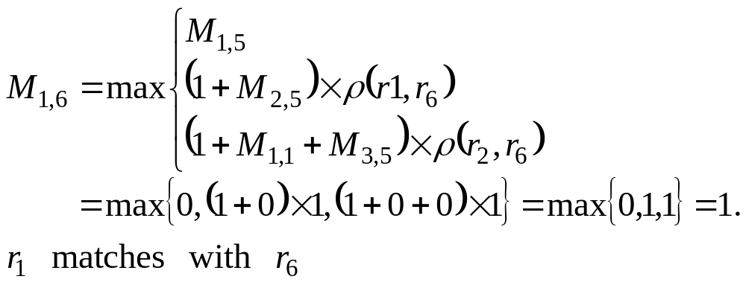
The Maximum Number of Base Pairs of the RNA Sequence
(3) i = 1, j = 6, ρ(r₁, r₆) = ρ(A, U) = 1

Slide 19
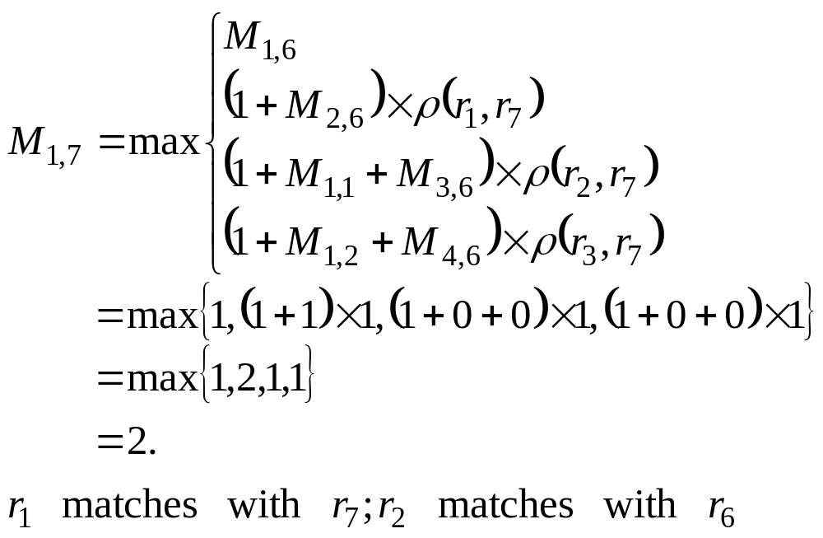
The Maximum Number of Base Pairs of the RNA Sequence
(4) i = 1, j = 7, ρ(r₁, r₇) = ρ(A, U) = 0

Slide 20
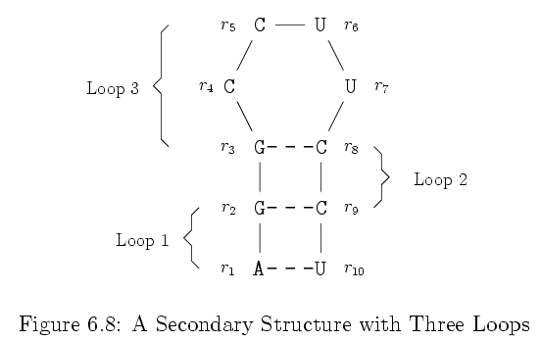
Loop Dependent Free Energy Rules
Introduction

Slide 21
Loop 1: {r₁, r₂, r₉, r₁₀} (i.e., A-G-C-U)
Loop 2: {r₂, r₃, r₈, r₉} (i.e., G-G-C-C)
Loop 3: {r₃,r₄,r₅,r₆,r₇,r₈} (i.e., G-C-C-U-U-C)
Loop | Exterior BP | Interior BP | Size | Degree
1 | (r₁, r₁₀) | (r₂, r₉) | 0 | 2
2 | (r₂, r₉) | (r₃, r₈) | 0 | 2
3 | (r₃, r₈) | No | 4 | 1

Slide 22
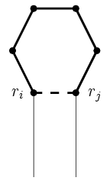
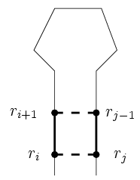
Various Types of Loops
Hairpin loop: A loop of degree 1 is called a hairpin loop.
Stacked pair: A loop of degree 2 is called a stacked pair if its size is zero.
(a) (b)

Slide 23
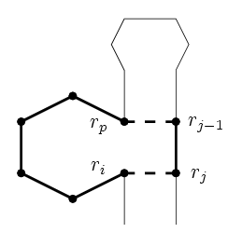
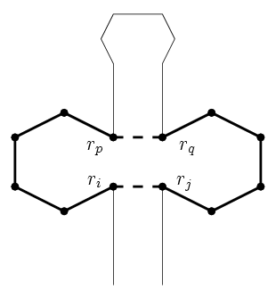
Bulge loop: A loop of degree 2 and non-zero size is called a bulge loop if its exterior and interior base pairs are adjacent.
Interior loop: A loop of degree 2 and non-zero size is called an interior loop if its exterior and interior base pairs are not adjacent.
(c) (d)

Slide 24
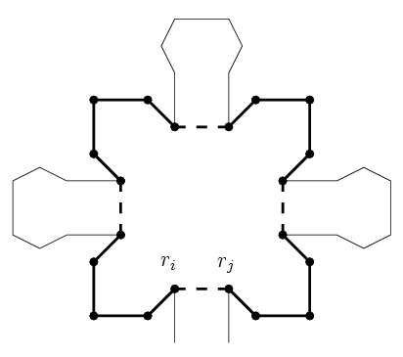
Multiloop: A loop of degree greater than 2 is called a multiloop.
(e)

Slide 25
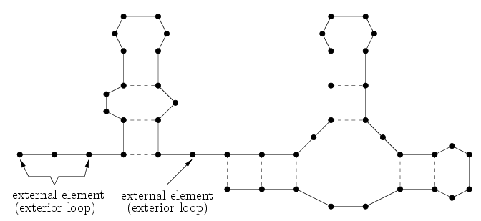
Exterior loop

Slide 26
The Energy of Secondary Structure
If we assign an energy to each loop in S, then the free energy of S is assumed to be the sum of the energies of all loops.
The unfolded sequence─ exterior loops do not contribute any energy.
We assume that the energies of exterior loops are zero.

Slide 27
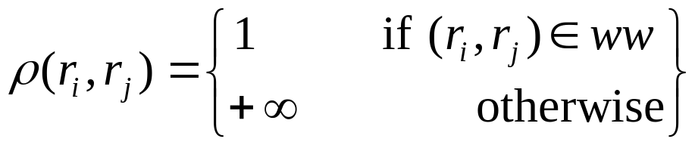
Minimum Free Energy Algorithm
The problem is to find an optimal secondary structure (i.e., a secondary structure with the minimum free energy).
G≡C, A=U and G−U
A function ρ(r_{i}, r_{j}) to indicate whether any two bases r_{i} and r_{j} can be a legal base pair:
where ww={(A,U), (U,A), (G,C), (C,G), (G,U), (U,G)}

Slide 28
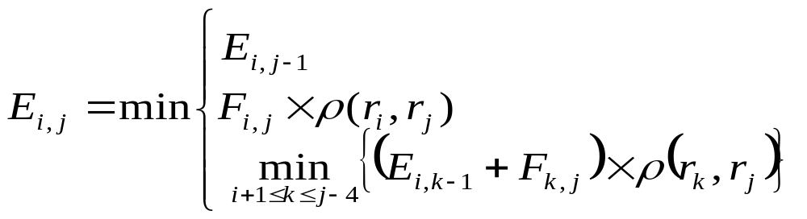
Let S_{i,j} denote the optimal structure of the substring R_{i,j}=r_{i}r_{i+1}…r_{j}.
Let E_{i,j} denote the free energy of S_{i,j}.
To compute E_{i,j},
Let L_{i,j} denote the structure with the minimum free energy in the case.
Let F_{i,j} denote the free energy of L_{i,j}.

Slide 29
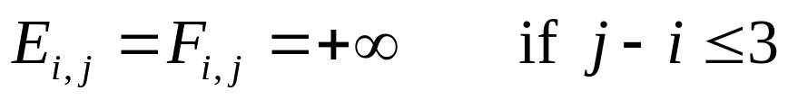
By definition, r_{i} and r_{j} cannot form a base pair if j – i ≤ t = 3 since R_{i,j} does not fold itself too sharply.
We have to set the boundary conditions of functions E and F as follows.

Slide 30
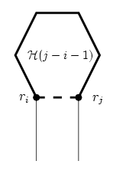
The Energies of Various Loops
Since (r_{i},r_{j}) is a base pair in L_{i,j}, (r_{i},r_{j}) must be an exterior base pair of some one loop, say L.
Case 1: L is a hairpin loop. Let H(k) denote the energy of a hairpin loop with size k.
  the size of L = j – i – 1
  F_{i,j}=H( j – i – 1)

Slide 31
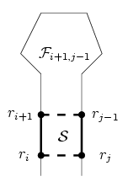
Case 2: L is a stacked pair. Let S denote the energy of a stacked pair.
  F_{i,j}=S +F_{i+1,j-1}
Case 3: L is a bulge loop.
Let B(k) denote the energy
of a bulge loop with size k. Let (r_{p},r_{q}) be the interior base pair of L.
  ∵ (r_{i},r_{j}) and (r_{p},r_{q}) are adjacent
  ∴ either p = i + 1 or q = j – 1 (but not both)

Slide 32
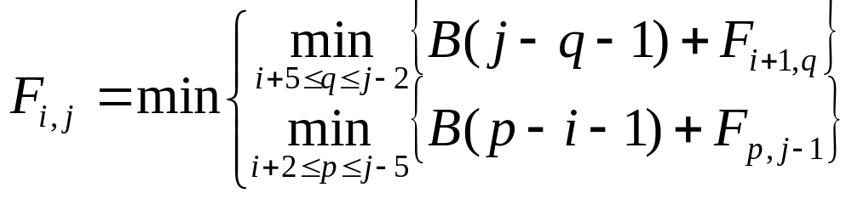
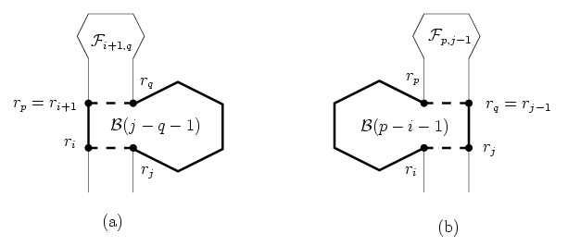

Slide 33
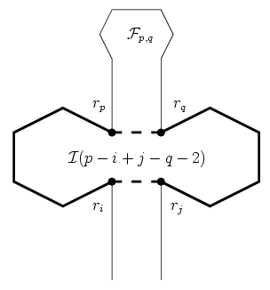
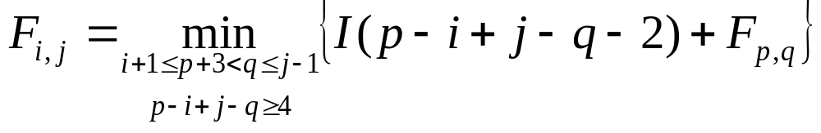
Case 4: L is an interior loop. Let I(k) denote the energy of an interior loop with size k.
  i+1 ≤ p+3 < q ≤ j – 1
  the size of L = p – i + j – q – 2
  ∵ (r_{i},r_{j}) and (r_{p},r_{q}) are not adjacent
  ∴ p – i + j – q ≥ 4

Slide 34
Case 5: L is a multiloop. Let M denote the energy of a multiloop, which usually expressed by the followed affine penalty function.
  M = M_{E} + M_{I} × (degree – 1) + M_{B} × size
  where
  M_{E}, M_{I} and M_{B} are constants, and degree and size are the degree and size of the loop, respectively.
Suppose that (r_{p},r_{q}) is the rightmost interior base pair of L.

Slide 35
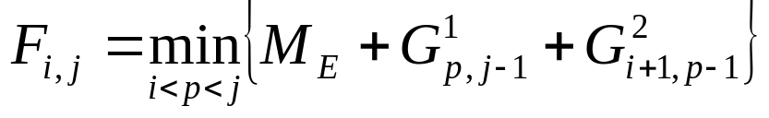
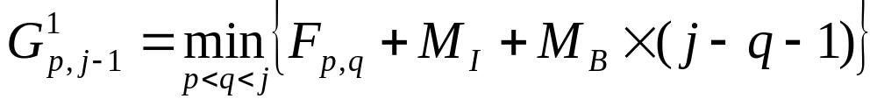
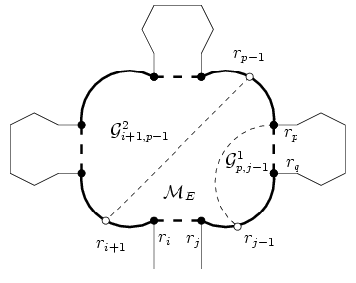
  where

Slide 36
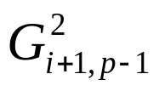
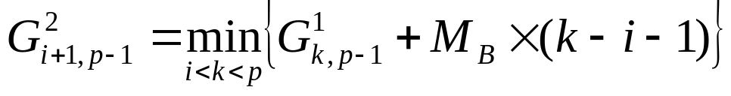
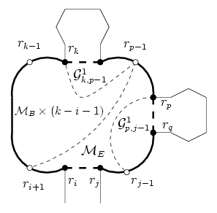
  is the minimum free energy of the remaining section L’ of L.
    Case 1: Suppose that L’ contains only one loop.

Slide 37
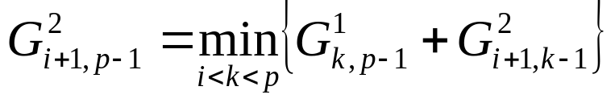
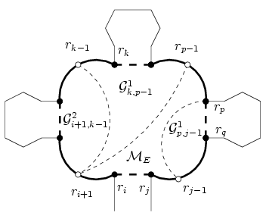
    Case 2: Suppose that L’ contains two or more loops.

Slide 38
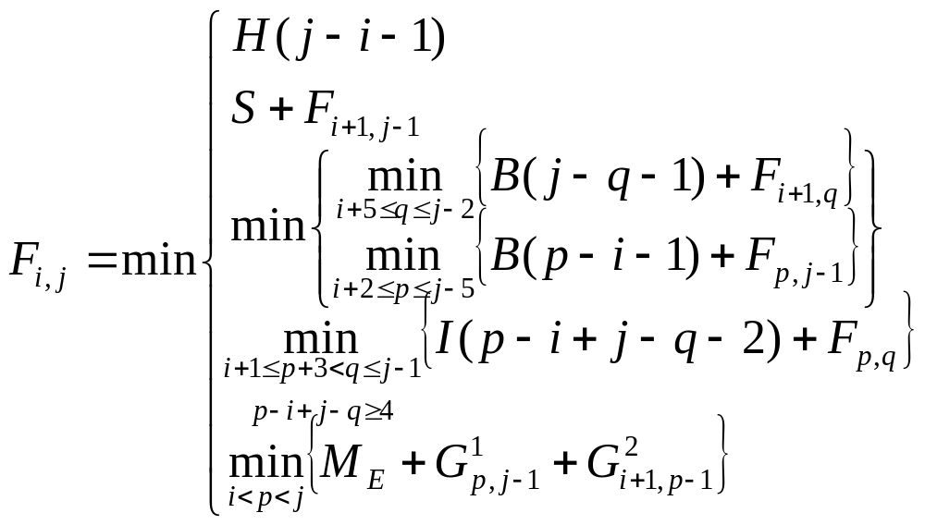
Recursive Formula to Compute F_{i,j}
If j – i ≤ 3, then F_{i,j}= +∞
If j – i > 3, then

Slide 39
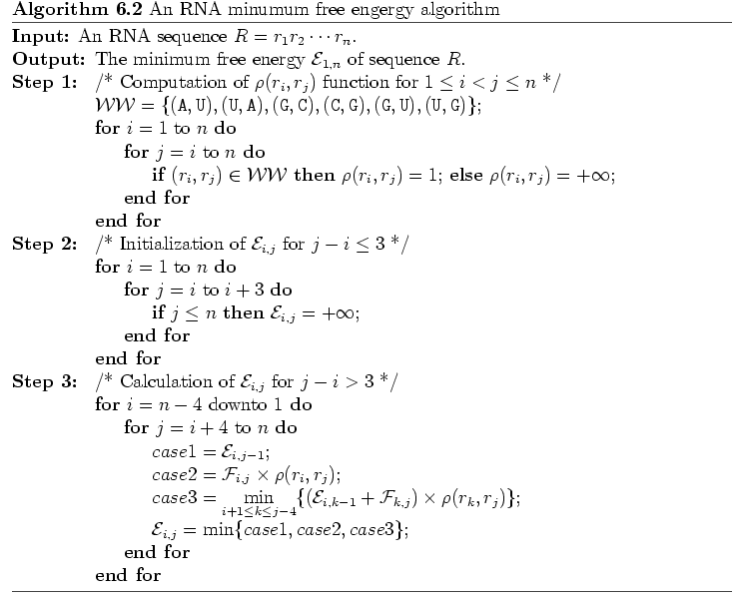
Algorithm

Slide 40
Time Complexity of Algorithm
The cost of step 1 and 2 are O(n²).
The cost of step 3 is O(n³).
The preprocessing of F_{i,j} costs O(n⁴) time.
The total time complexity of algorithm is O(n⁴).

